Slide 1




MEDIBOND
BLOCKCHAIN THAT HEALS

Slide 2



OUR TEAM
Moinuddin
Cybersecurity Engineer
Amaan
AI / ML Engineer
Wafiq
Software Engineer

Slide 3
THE PROBLEM
“What If the Medicine That Was Meant to Heal You... Was Fake?”
Over 250,000 people die every year
This isn’t fiction — it’s happening every day around the world.”

Slide 4


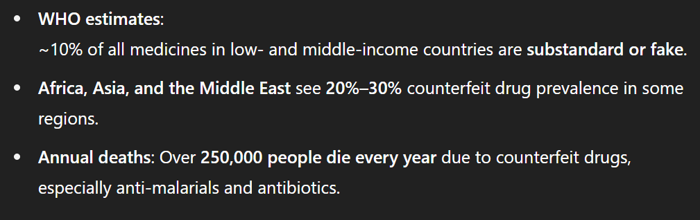

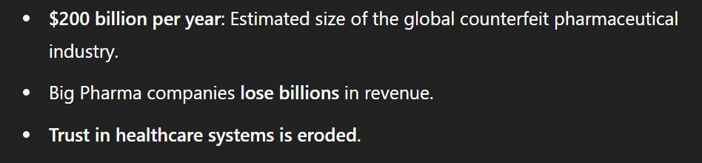

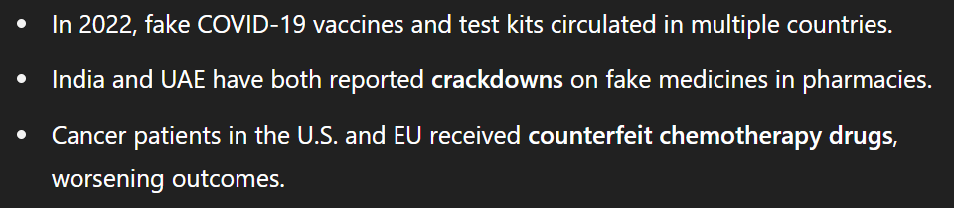


Slide 5





THE SOLUTION
“Our Solution: MediBond — Verifying Medicines with Blockchain”
We follow
5 UN SDG !
Notes:
We meet 5 UN Sustainable Development Goals
Protects patients from harmful fake medicines.
Uses blockchain tech to modernize medicine tracking.
Ensures safe, traceable use of genuine medicines.
Creates transparency and accountability in drug supply
Connects stakeholders in a trusted health ecosystem..

Slide 6
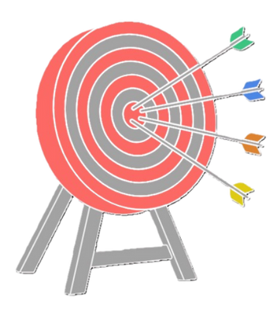

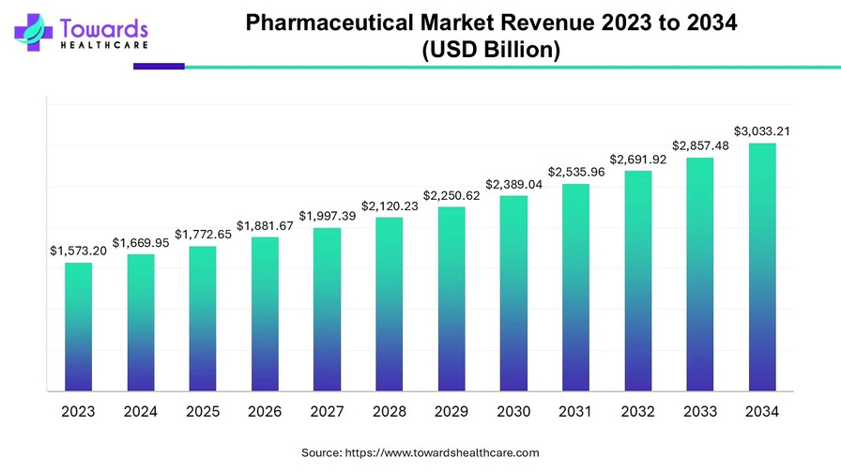
WE MOVE GLOBALLY WITH ENDLESS LIMIT
Target
Market
Our target is endless
It includes all people of all
age groups and countries
DIAMANTE will enable us to enter the vast pharmaceutical industry and drive significant growth.
1.6 Trillion Dollars
in Revenue

Slide 7
OUR BUSINESS MODEL
USING DIAMANTE SERVICES
VENDOR COMISSIONS
we charge companies and authorised reseller for listing themselves on our Diamante powered store
Blockchain-as-a-Service
(BaaS) for Pharma Companies
Pharma manufacturers pay to register medicine batches on Diamante blockchain
Global API for E-commerce
Offer an Diamante based API for online pharmacies, delivery apps, and telehealth companies

Slide 8
MARKET STRATEGY
We become the Approval !
"Market access begins with us — and comes at a price."
LEGAL REGULATIONS
“MediBond is a government-approved Compliance”

Slide 9
FUTURE PLANS
“Secured verified Organ Matching — Subscription-Based Access”
“AI-Powered Risk Prediction for Counterfeit Hotspots”

Slide 10
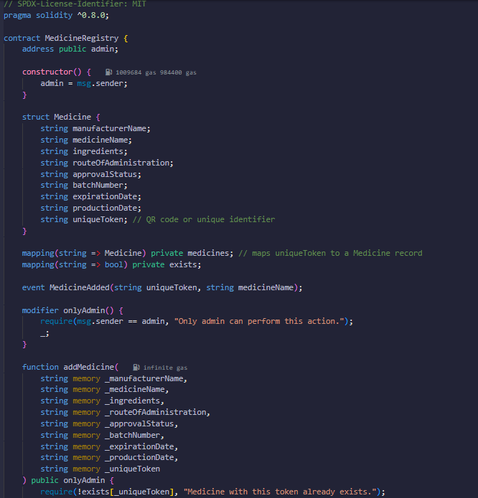
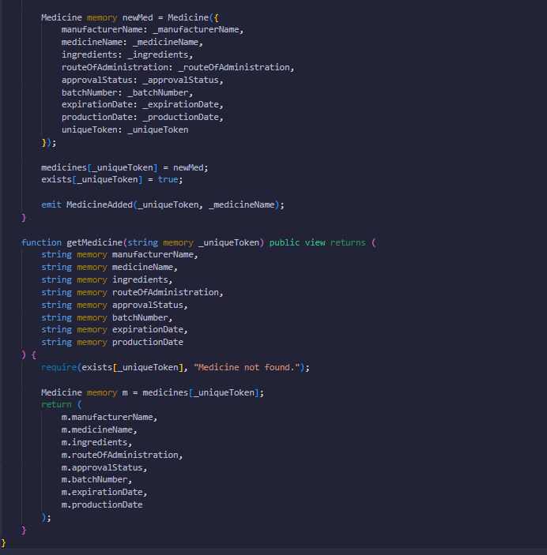
SOLIDITY CODE FOR MEDIBOND
Notes:
The Solidity code on the left defines a Medicine structure to store all relevant details for each medicine. It includes functionality to add new records while ensuring only the admin can add data and that duplicates are prevented. The code on the right enables anyone to view medicine details.

Slide 11
THANK YOU

